Slide 1
Recitation#11
TA: Tatheer Zahra (tzz5184@psu.edu)

Slide 2
Important Announcements
Grades for A.3 and T.7 have been uploaded.
Extra Credit is due this Friday. Submissions after 5 will have a 10% deduction.
Please check Canvas for announcements from Dan Kahn. This week he’d be announcing something very important related to the project
Sign Up sheet for Projects has been released
Project Teams of 3 people should be formed by 11th November.

Slide 3
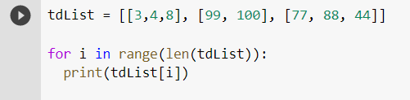
Review
In a nested loop, which loop represents rows, and which represents columns?
Outer loop is for traversing rows and inner loop for traversing columns
What is the loop doing below?
Getting smaller lists/rows from the bigger list

Slide 4
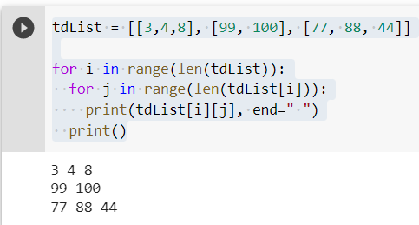
Review
How do we add nested loops to the previous code and get individual elements?

Slide 5
Practice Problem
Go to Files in your recitation page and download test.txt
There are two lines in the text file, where the first line has names of the recitations, and the second line has class average of that recitation.
Read data from test.txt and save it in a 2D list.
Traverse the two lists and count how many sections are below 75.
Write the recitation names, averages and count of the sections below 75 into a csv file.

Slide 6

Output

Slide 7
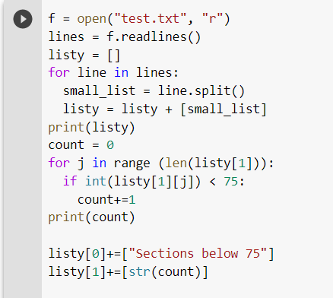
Code

Slide 8
Prepare for timed test
Sign into canvas and pull up the recitation page on the lab computer ​​
Clear workspace (no notes, no phones, all away)​
You will hear me call out time warnings. Please manage your time!​​
Raise your hand if you have any questions ​​
Remember this timed test only covers material from Modules 10. Can refer to Syllabus “Important” section for prohibited constructs​
Don’t need comment header or specific file name (only for lab assignments)​
When you are done, take a picture of your submission page and sign out with the LA at the front.

Slide 9
Timed Test
Time test will be due in 30 minutes​​. You should mark your attendance after 15 minutes to be considered for grading.
Read the instructions carefully.
If you have a question, raise your hands.
Password: MovemberMove

